Slide 1
Android 期末專題
My Reminder

Slide 2
Agenda
Motivation of creating this app
GUI introduction
Used Activity and Classes
Demo

Slide 3
Motivation

Slide 4
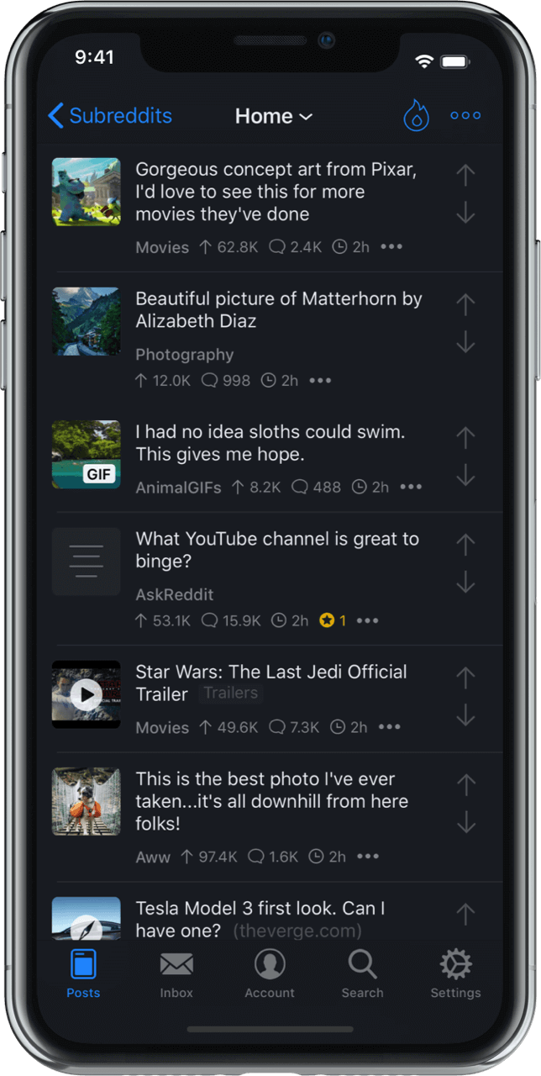
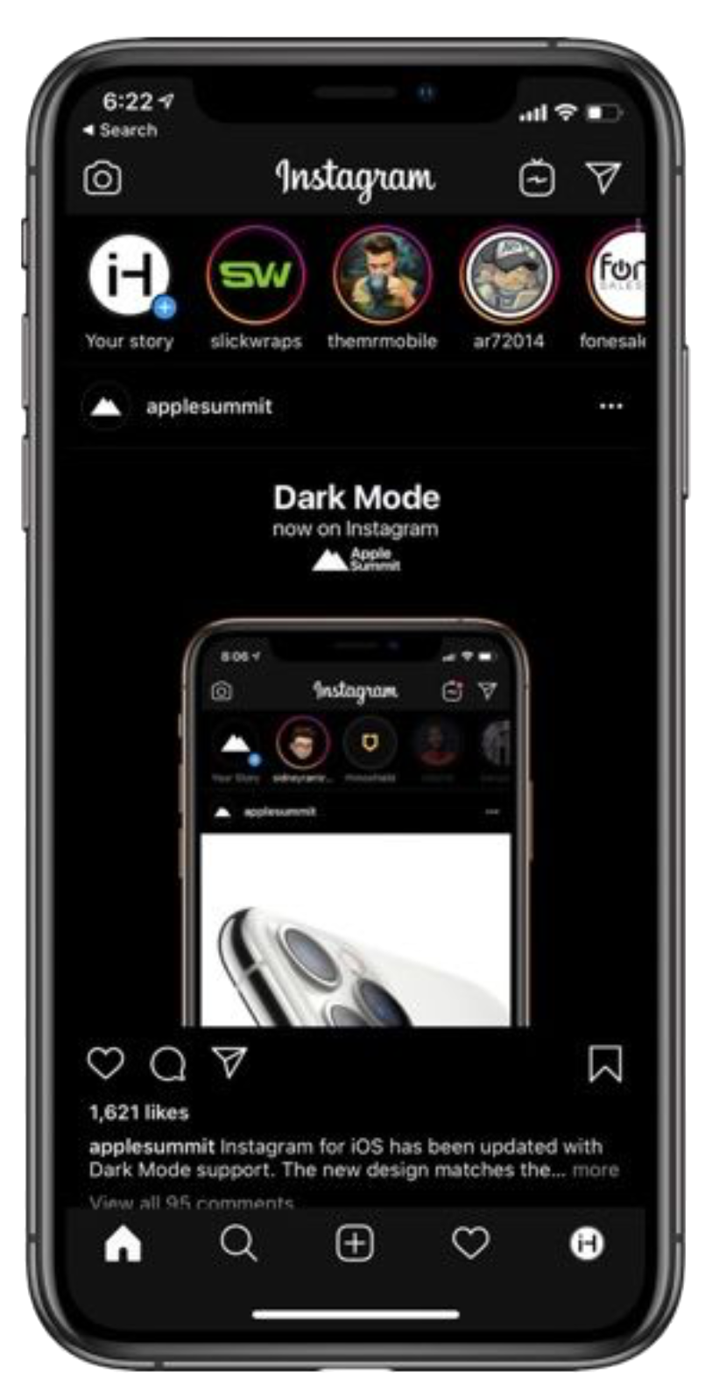
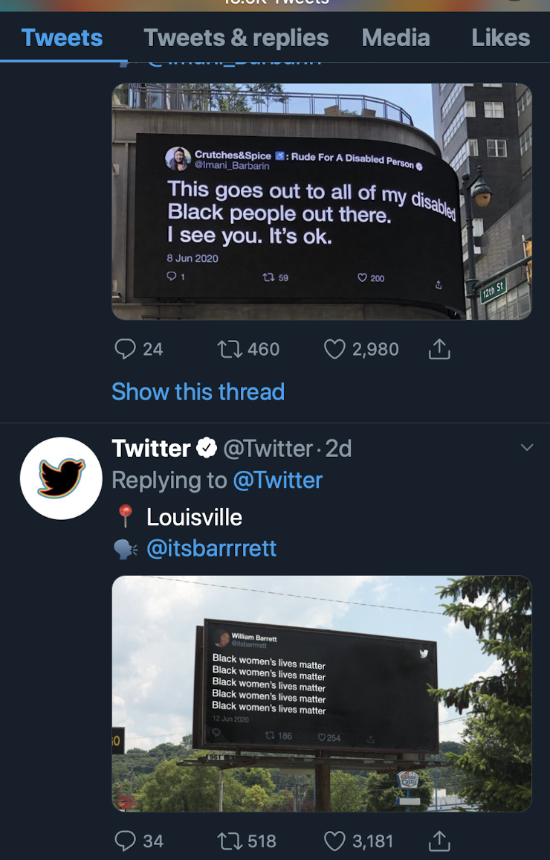
Programmatic, Dynamic Layout

Slide 5
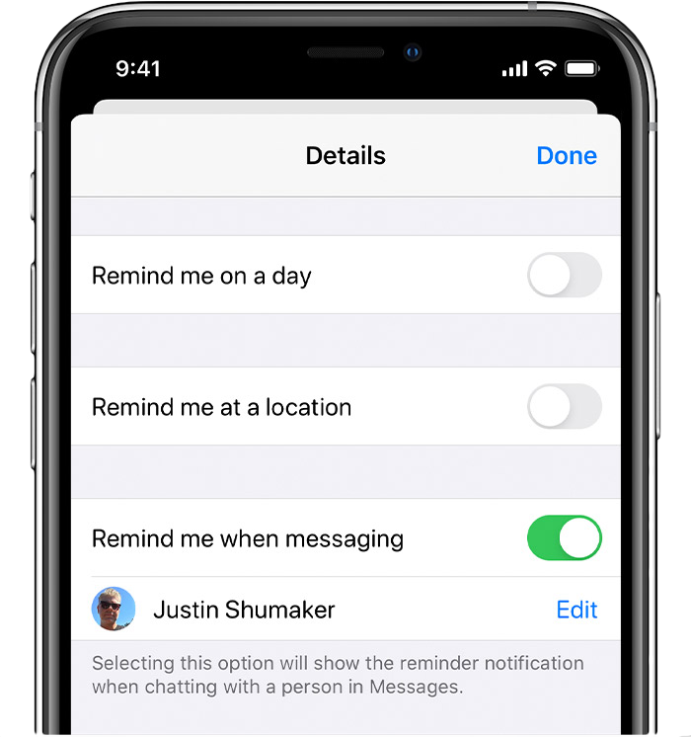
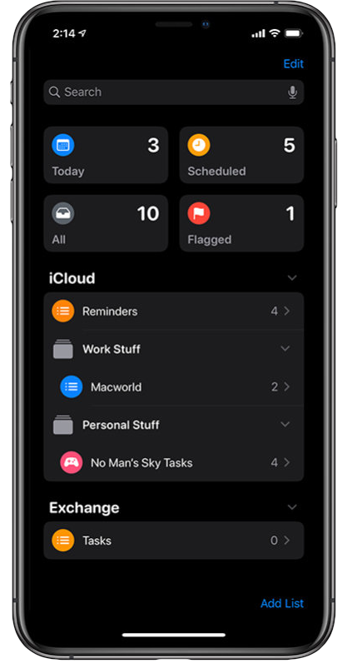
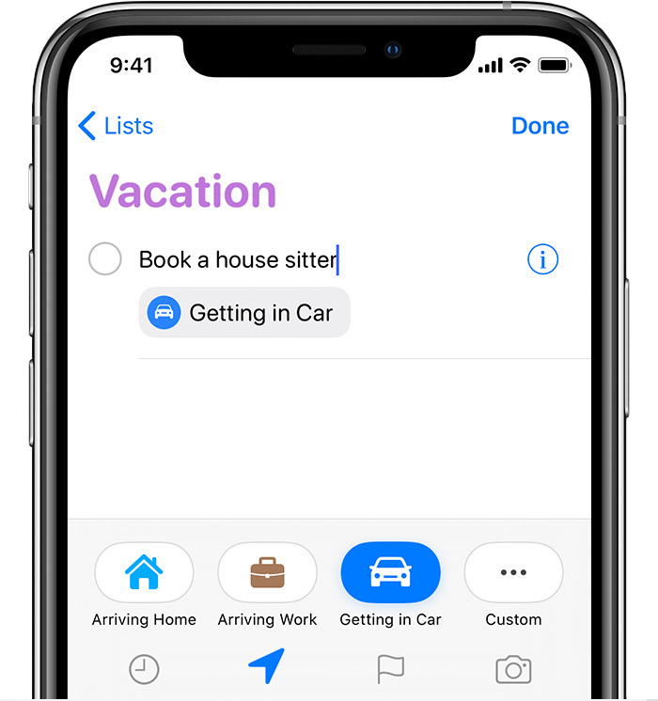
Expandable

Slide 6
GUI

Slide 7
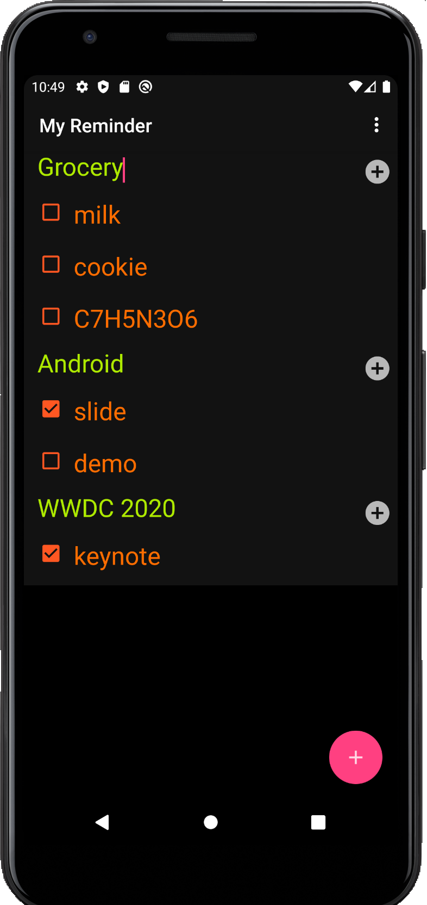
Tap to dismiss keyboard
Category
items
Add
new items
Add
new category

Slide 8





Slide 9
Used Classes and
Activities

Slide 10
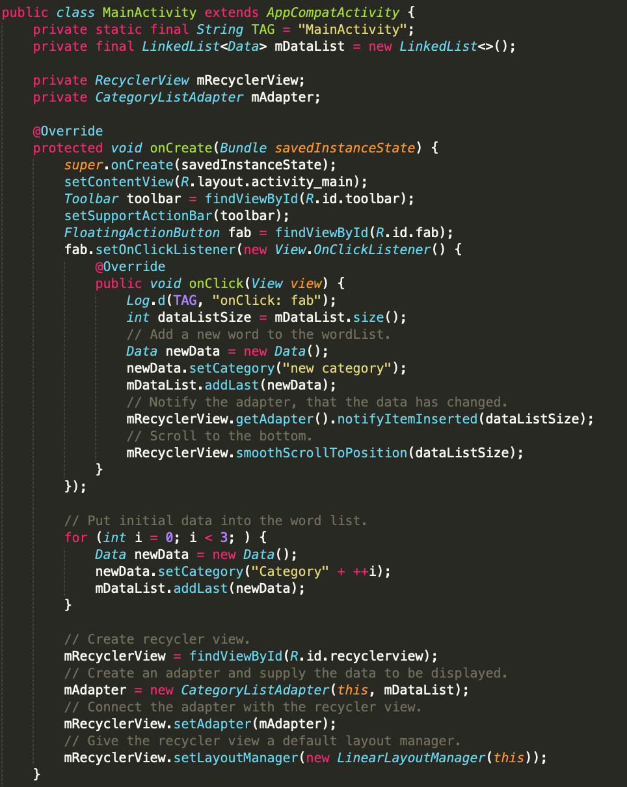
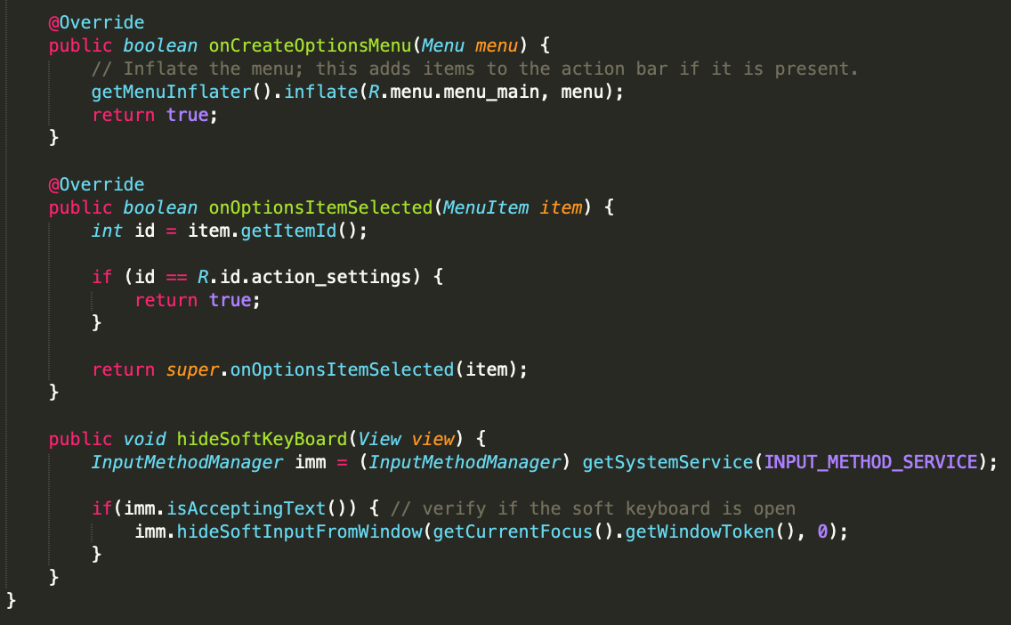
Main Activity

Slide 11
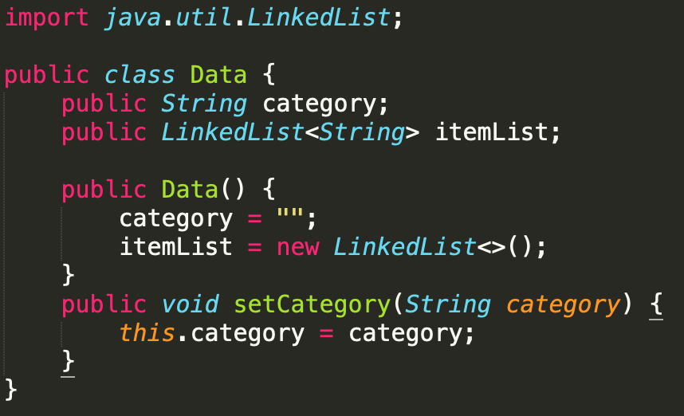
Data

Slide 12
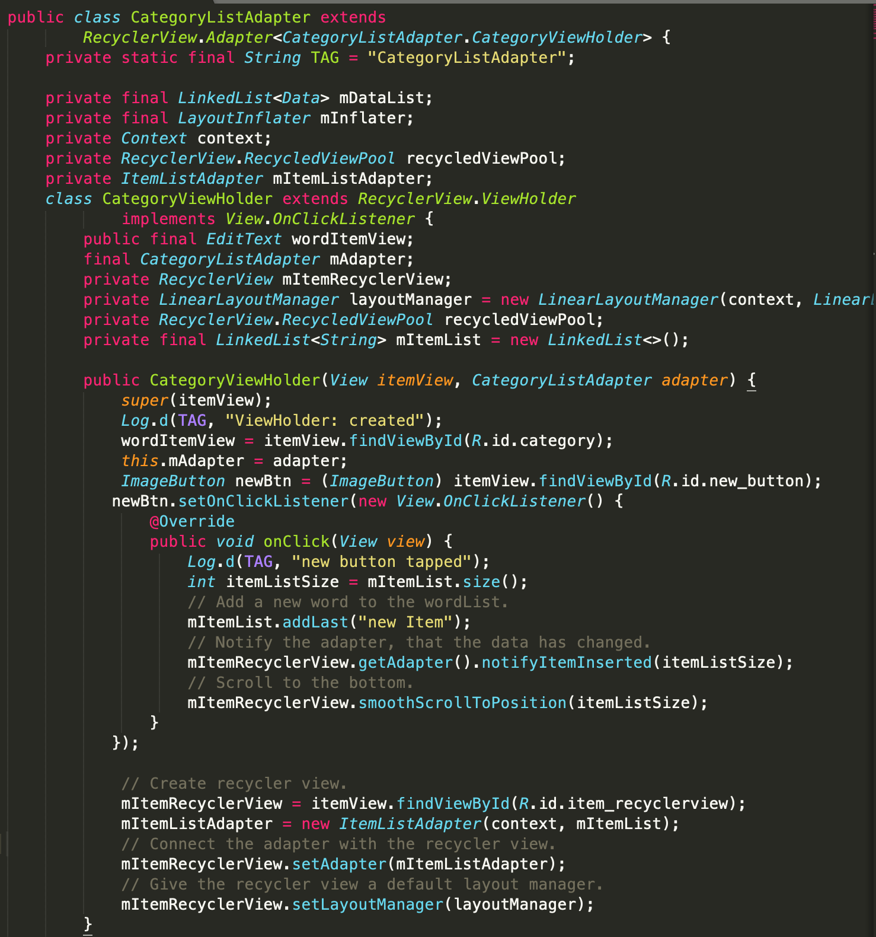
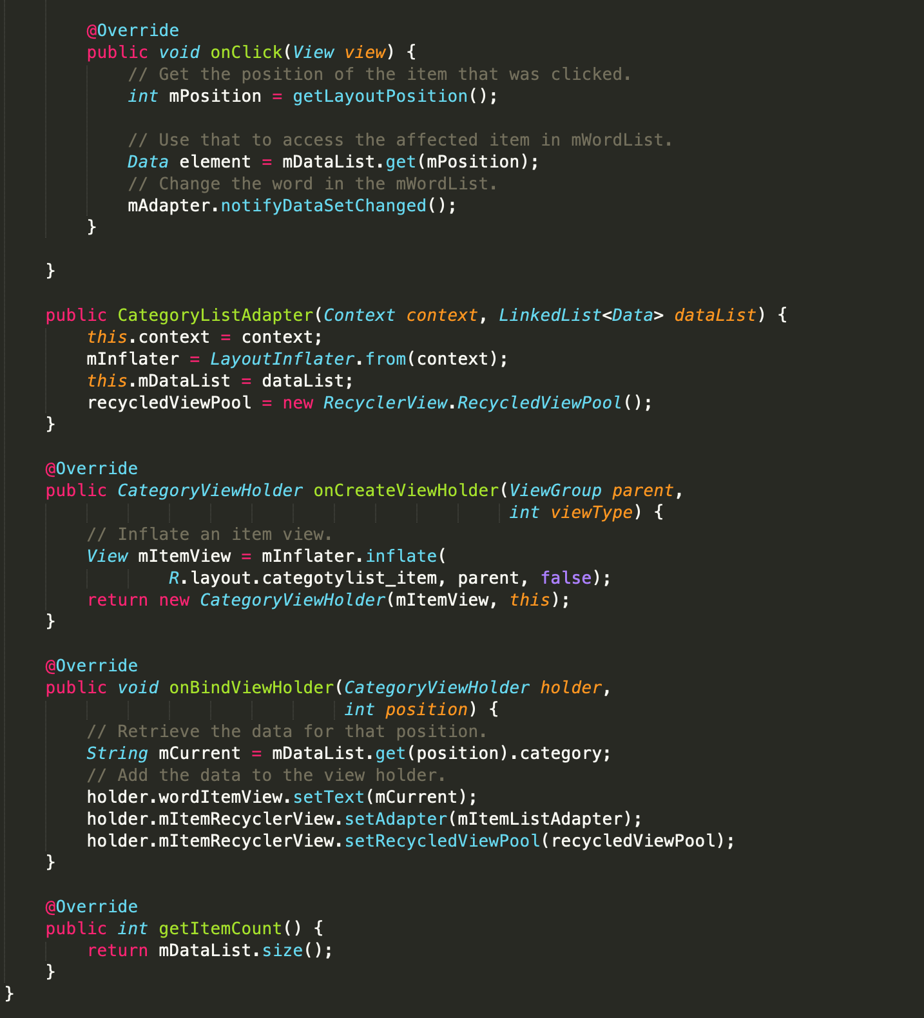
CategoryListAdapter

Slide 13
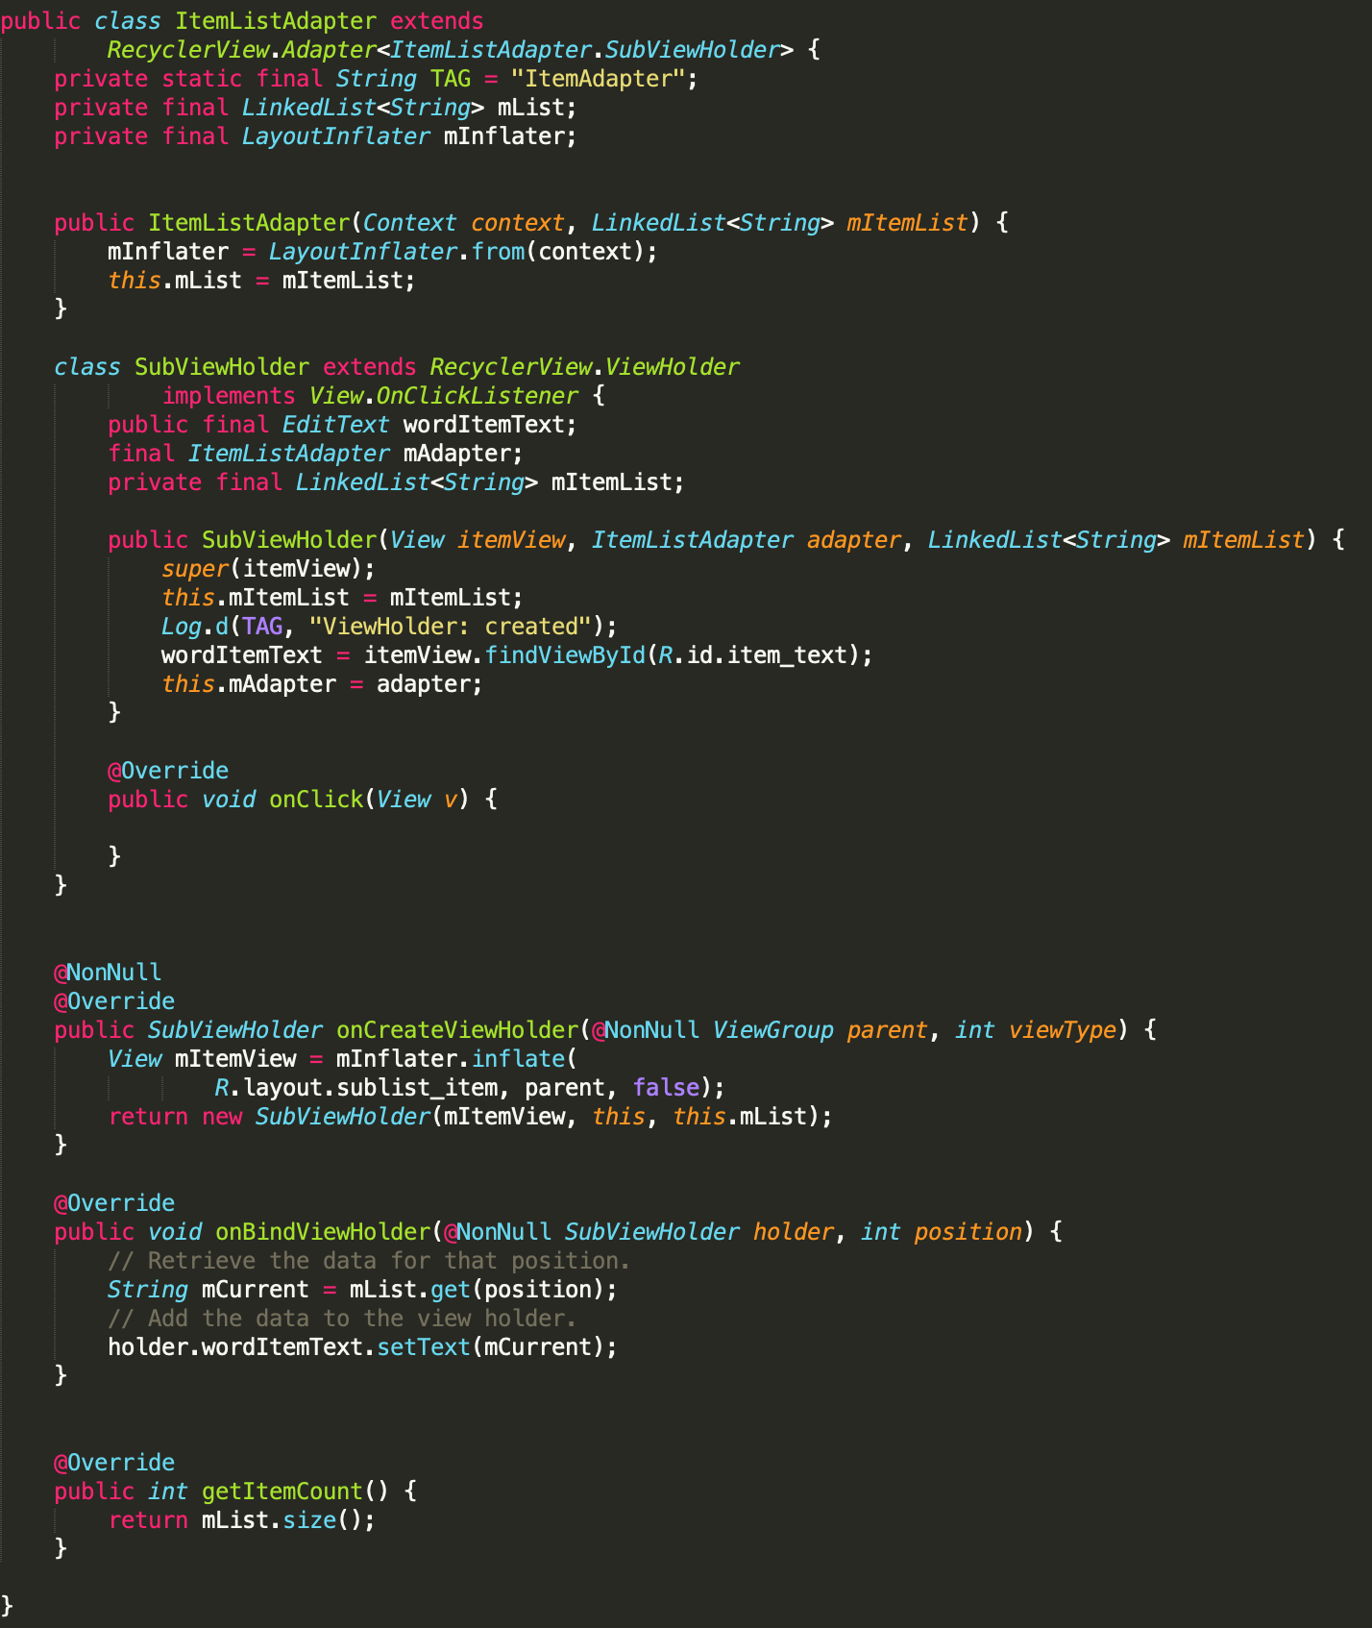
ItemListAdapter

Slide 14
Demo

Slide 15
